Slide 1
Sample Space
Probability implies random experiments.
A random experiment can have many possible outcomes; each outcome known as a sample point (a.k.a. elementary event) has some probability assigned. This assignment may be based on measured data or guestimates.
Sample Space S : a set of all possible outcomes (elementary events) of a random experiment.
  Finite (e.g., if statement execution; two outcomes)
  Countable (e.g., number of times a while statement is executed; countable number of outcomes)
  Continuous (e.g., time to failure of a component)
Notes:
Sample space aka Universe, Universal space etc.
Finite : The number of elements is some finite number (< )
Countable → S = {x1, x2, x3, …}, i.e., with each element, we can associate a numbered index (ordinality).
Continuous → S = {x(t), t  }

Slide 2

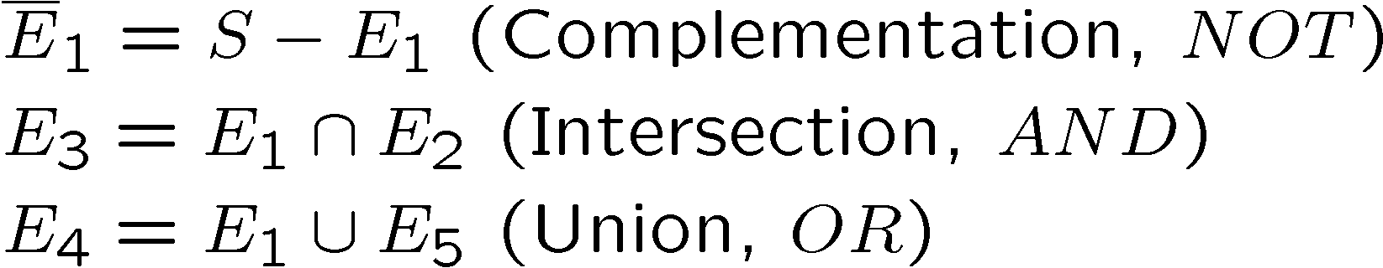
Events
An event E is a collection of zero or more sample points from S
S and E are sets ➔ use of set operations.
Notes:
E’₁ = { x| x  S AND x  E₁}

Slide 3

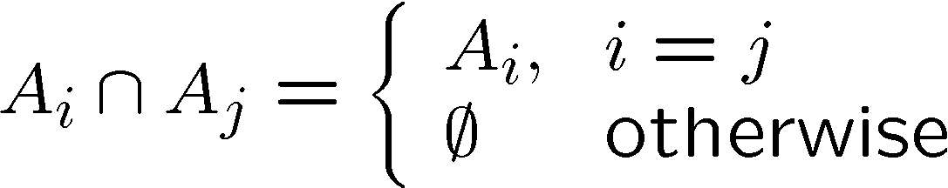
Algebra of events
Sample space is a set and events are the subsets of this (universal) set.
Use set algebra and its laws on p. 9.
Mutually exclusive (disjoint) events

Slide 4

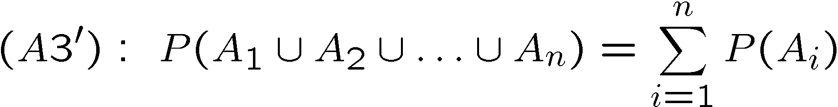
Probability axioms
(see pp. 15-16 for additional relations)

Slide 5

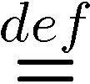
Probability system
Events, sample space (S), set of events.
Subset of events that are measurable.
F :Measurable subsets of S
  F be closed under countable number of unions and intersections of events in F .
  -field: collection of such subsets F .
Probablity space (S, F , P)

Slide 6
Combinatorial problems
Deals with the counting of the number of sample points in the event of interest.
    Assume equally likely sample points:
    P(E)= number of sample points in E / number in S
  Example: Next two Blue Devils games
    S = {(W1,W2), (W1,L2), (L1,W2), (L1,L2)}
    {s1, s2, s3, s4}
    P(s1) = 0.25= P(s2) = P(s3) = P(s4)
    E1: at least one win {s1,s2,s3}
    E2: only one loss {s2, s3}
    P(E1) = 3/4; P(E2) = 1/2

Slide 7
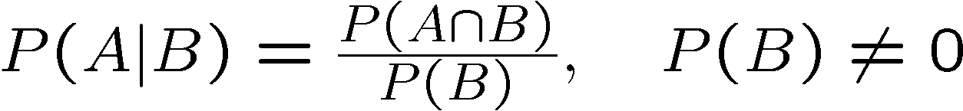
Conditional probability
In some experiment, some prior information may be available, e.g.,
  What is the probability that Blue Devils will win the opening game, given that they were the 2000 national champs.
  P(e|G): prob. that e occurs, given that ‘G’ has occurred.
In general,

Slide 8

Mutual Independence
A and B are said to be mutually independent, iff,
Also, then,

Slide 9

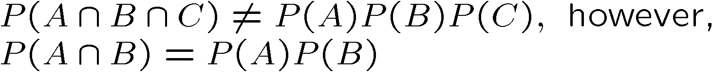
Independent set of events
Set of n events, {A₁, A₂,..,A_{n}} are mutually independent iff, for each
Complements of such events also satisfy,
Pair wise independence (not mutually independent)
Notes:
k = 2 → nC2 sets of distinct pairs, each pair should exhibit mutual independence.
k=3 → nC3 sets of distinct triplets. Each triplet should exhibit mutual independence and so on.

Slide 10
Series-Parallel systems

Slide 11
Series system
Series system: n statistically independent components.
Let, R_{i} = P(E_{i}), then series system reliability:
For now reliability is simply a probability, later it will be a function of time

Slide 12
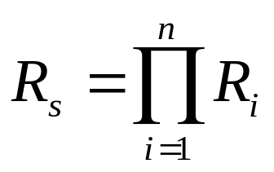
Series system (Continued)
(2)
R1
R2
Rn
This simple PRODUCT LAW OF RELIABILITIES,
is applicable to series systems of independent
components.

Slide 13
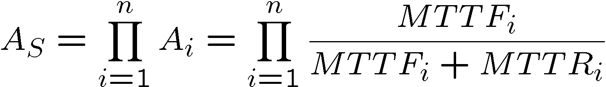
Series system (Continued)
Assuming independent repair, we have product law of availabilities

Slide 14
Parallel system
System consisting of n independent parallel components.
System fails to function iff all n components fail.
E_{i} = "component i is functioning properly"
E_{p} = "parallel system of n components is functioning properly."
R_{p} = P(E_{p}).

Slide 15
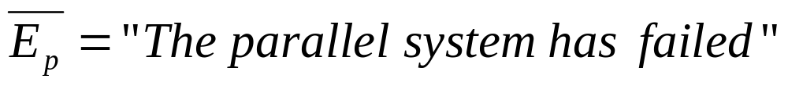
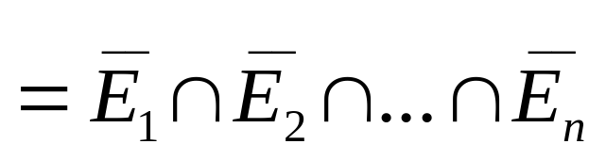
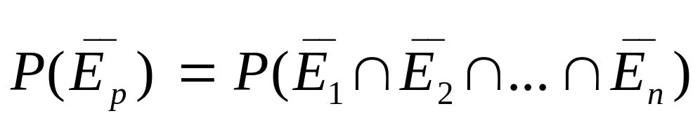
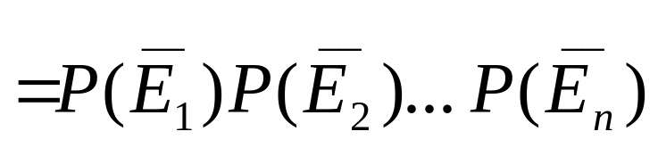
Parallel system (Continued)
Therefore:

Slide 16
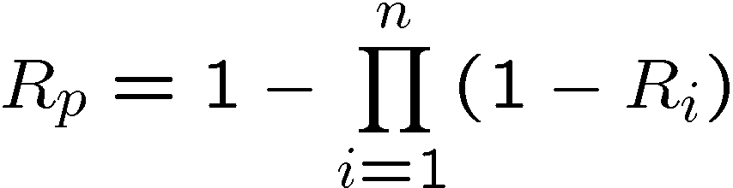
Parallel system (Continued)
R1
.
.
.
Parallel systems of independent components follow the PRODUCT LAW OF UNRELIABILITIES
.
.
.
Rn

Slide 17
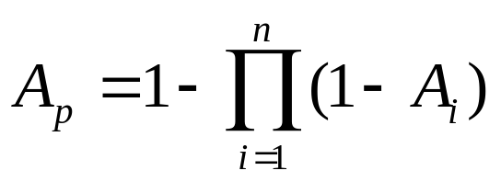
Parallel system (Continued)
Assuming independent repair, we have product law of unavailabilities:

Slide 18
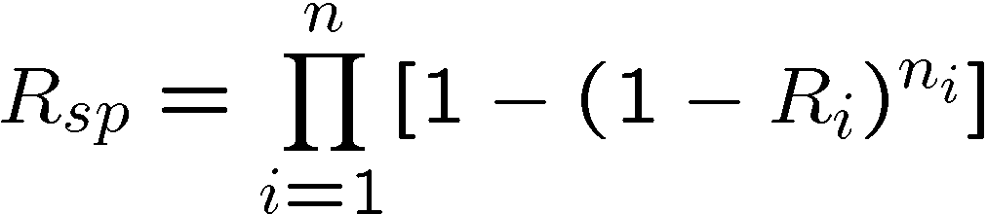
Series-Parallel System
Series-parallel system: n-series stages, each with n_{i} parallel components.
Reliability of series parallel system
Notes:
R_{sp} assumes that all the parallel components in the ith block have same reliability R_I.

Slide 19
Series-Parallel system (example)
voice
control
voice
control
voice
Example: 2 Control and 3 Voice Channels

Slide 20
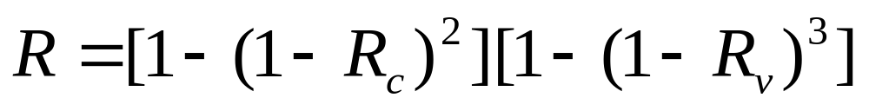
Series-Parallel system (Continued)
Each control channel has a reliability R_{c}
Each voice channel has a reliability R_{v}
System is up if at least one control channel and at least 1 voice channel are up.
Reliability:
(3)

Slide 21
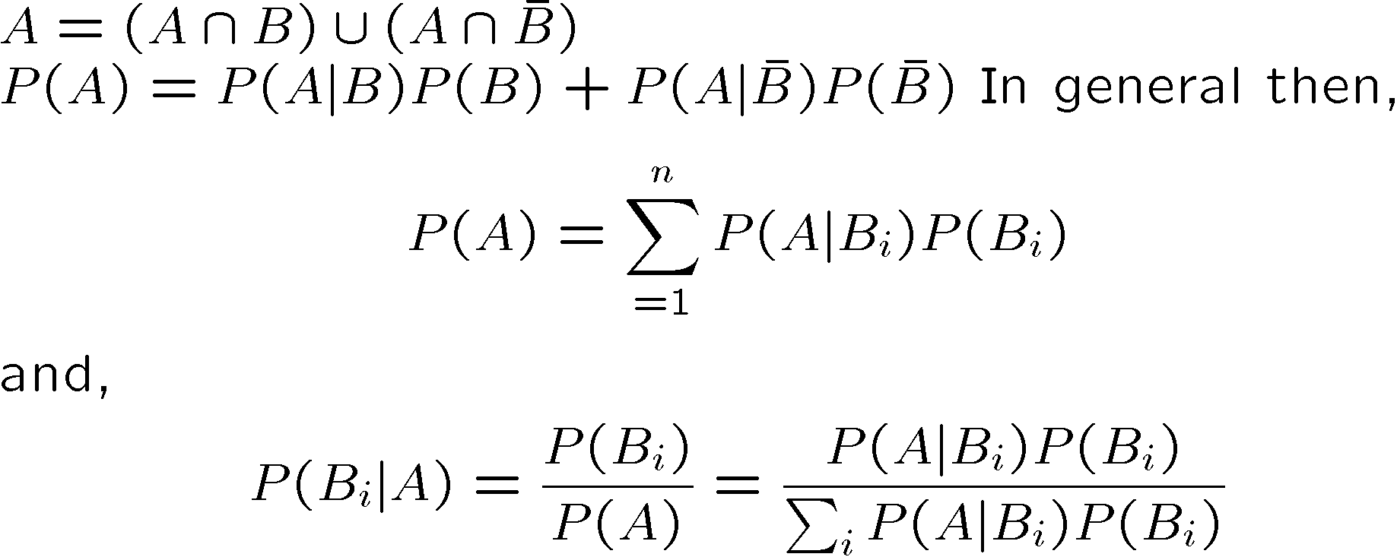
Theorem of Total Probability
Any event A: partitioned into two disjoint events,
Notes:
P(B_{i}|A) – a-posteriori probability i.e. is the observed radar signal and Bi is the target detection
Event, then P(B_{i}|A) implies the probability of detection AFTER observing the signal.

Slide 22
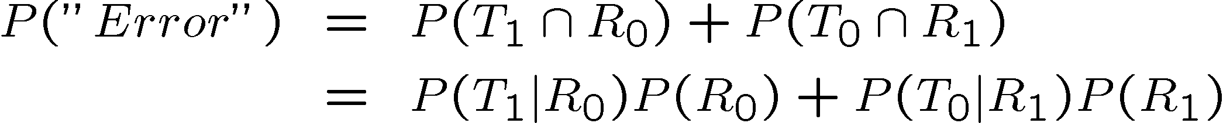
Example
Binary communication channel:
P(R₀|T₀)
T₀
R₀
Given:
P(R₀|T₀) = 0.92; P(R₁|T₁) = 0.95
P(T₀) = 0.45; P(T₁) = 0.55
P(R₀|T₁)
P(R₁|T₀)
T₁
P(R₁|T₁)
R₁
P(R₀) = P(R₀|T₀) P(T₀) + P(R₀|T₁) P(T₁) (TTP)
= 0.92 x 0.45 + 0.08 x 0.55
= 0.4580

Slide 23
Bridge Reliability using conditioning/factoring

Slide 24
Bridge: conditioning
C1
C2
C3 down
S
T
C1
C2
C4
C5
S
C3
T
C4
C5
C3 up
C1
C2
Factor (condition)
on C3
S
T
C4
C5
Non-series-parallel block diagram

Slide 25
Bridge (Continued)
Component C3 is chosen to factor on (or condition on)
Upper resulting block diagram: C3 is down
Lower resulting block diagram: C3 is up
Series-parallel reliability formulas are applied to both the resulting block diagrams
Use the theorem of total probability to get the final result

Slide 26
Bridge (Continued)
R_{C3down}= 1 - (1 - R_{C1}R_{C2}) (1 - R_{C4}R_{C5})
A_{C3down}= 1 - (1 - A_{C1}A_{C2}) (1 - A_{C4}A_{C5})
R_{C3up} = (1 - F_{C1}F_{C4})(1 - F_{C2}F_{C5})
= [1 - (1-R_{C1}) (1-R_{C4})] [1 - (1-R_{C2}) (1-R_{C5})]
A_{C3up} = [1 - (1-A_{C1}) (1-A_{C4})] [1 - (1-A_{C2}) (1-A_{C5})]
R_{bridge} = R_{C3down} . (1-R_{C3} ) + R_{C3up} R_{C3}
_{also}
A_{bridge} = A_{C3down} . (1-A_{C3} ) + A_{C3up} A_{C3}

Slide 27
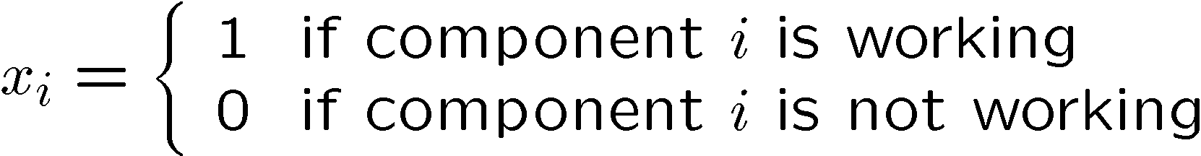
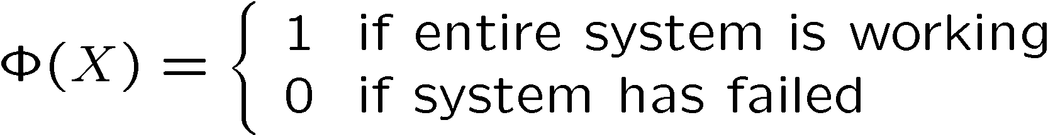

Fault Tree
Reliability of bridge type systems may be modeled using a fault tree
State vector X={x₁, x₂, …, x_{n}}

Slide 28
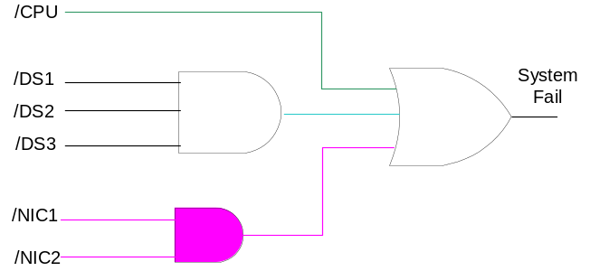
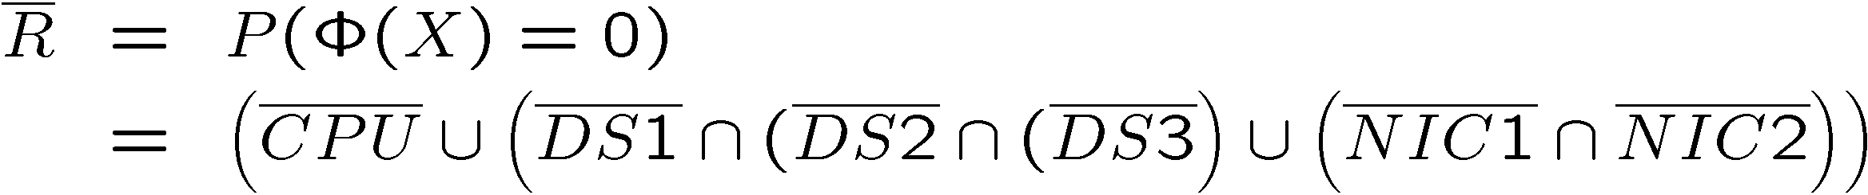
Fault tree (contd.)
Example:
DS1
NIC1
CPU
DS2
NIC2
DS3
Notes:
Using failure function and reliability fn. of different sub-systems, R can be computed.

Slide 29
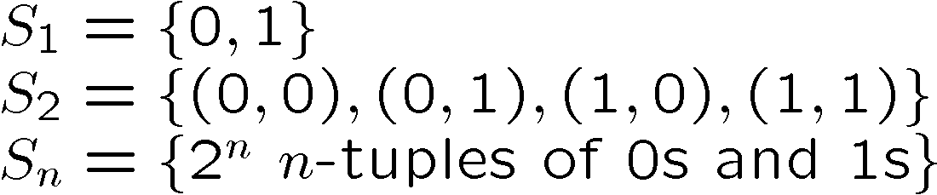
Bernoulli Trial(s)
Random experiment → 1/0, T/F, Head/Tail etc.
  e.g., tossing a coin P(head) = p; P(tail) = q.
Sequence of Bernoulli trials: n independent repetitions.
  n consecutive execution of an if-then-else statement
S_{n:} sample space of n Bernoulli trials
For S₁:

Slide 30


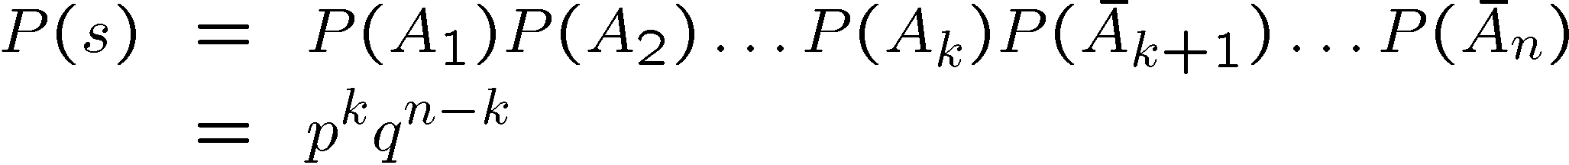
Bernoulli Trials (contd.)
Problem: assign probabilities to points in S_{n}
P(s): Prob. of successive k successes followed by (n-k) failures. What about any k failures out of n ?

Slide 31
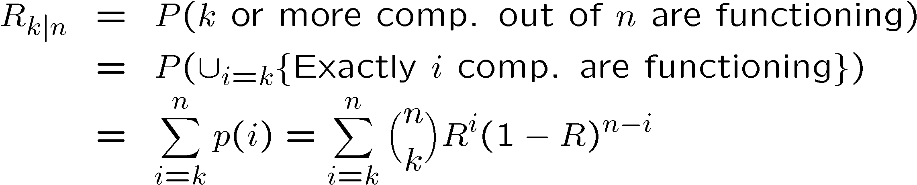
Bernoulli Trials (contd.)

Slide 32
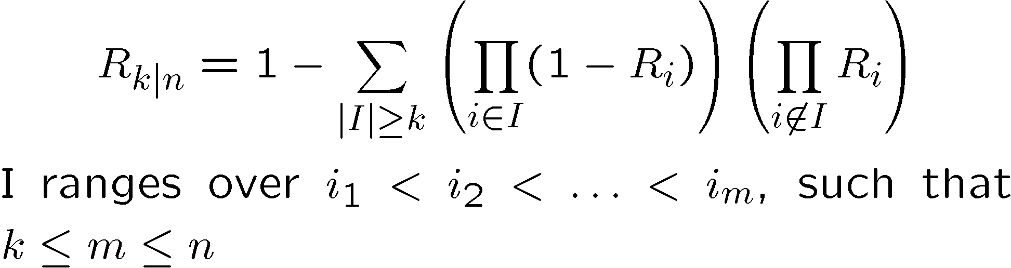
Nonhomogenuous Bernoulli Trials
Nonhomogenuous Bernoulli trials
  Success prob. for i^{th} trial = p_{i}
Example: R_{i} – reliability of the i^{th} component.
Non-homogeneous case – n-parallel components such that k or more out n are working:
Notes:
Where I ranges over all choices i1 < i2 <…< im, such that k <=m<=n. The first term represents the event that during the ith trial, more than k components have failed and remaining were working. Hence 1- … represents the reliability.

Slide 33
Generalized Bernoulli Trials
Each trial has exactly k possibilities, b₁, b₂, .., b_{k}.
p_{i} : Prob. that outcome of a trial is b_{i}
Outcome of a typical experiment is s,
Notes:
In contrast to a (binary) Bernoulli trial.

Slide 34
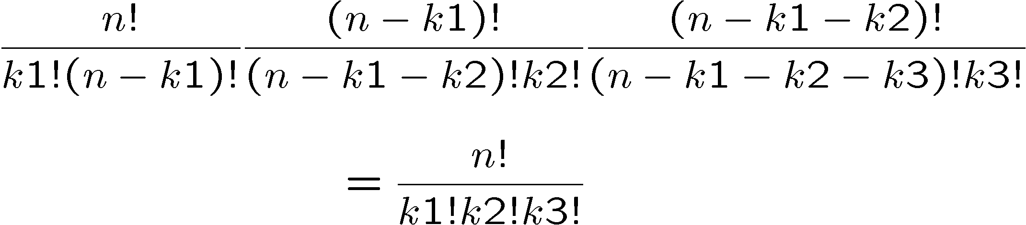
Total no. of possibilities:
C(n,k1), (n-k1, k2), c(n-k1-k2, k3)..

Slide 35
Methods for non-series-parallel RBDs
Factoring or conditioning
State enumeration (Boolean truth table)
minpaths
  inclusion/exclusion
  SDP (Sum of Disjoint Products) (implemented in SHARPE)
BDD (Binary Decision Diagram) (implemented in SHARPE)

Slide 36
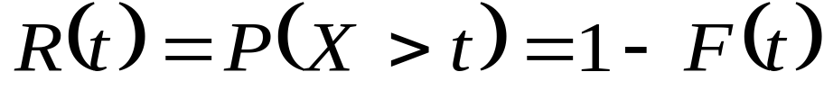
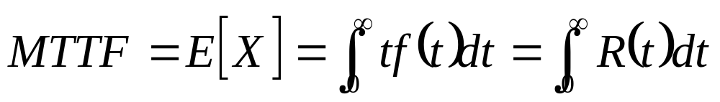
Basic Definitions
Reliability R(t):
X : time to failure of a system
F(t): distribution function of system lifetime
Mean Time To system Failure
f(t): density function of system lifetime

Slide 37
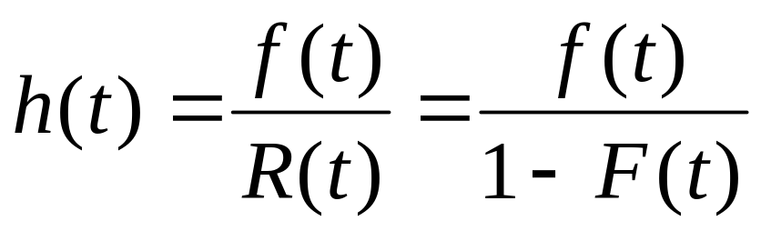
Reliability, hazard, bathtub
h(t) Δt = Conditional Prob. system will fail in
(t, t + Δt) given that it is survived until time t
f(t) Δt = Unconditional Prob. System will fail in
(t, t + Δt)

Slide 38
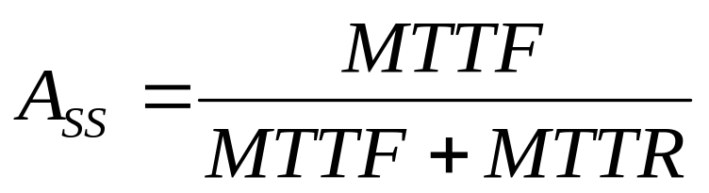
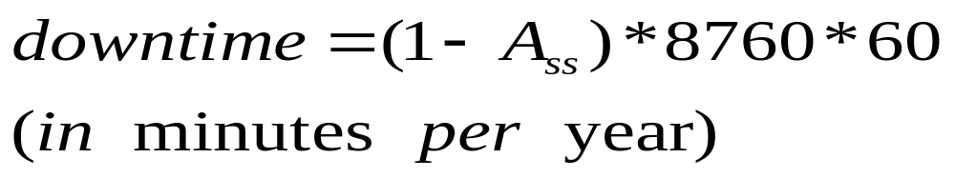
Availability
This result is valid without making assumptions on the form of the distributions of times to failure & times to repair.
Also:

Slide 39
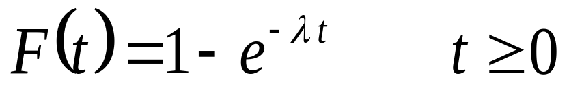
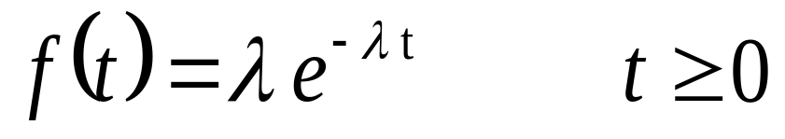
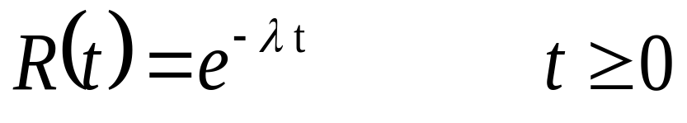
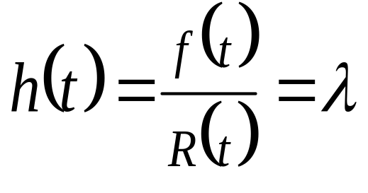
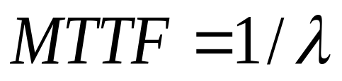
Exponential Distribution
Distribution Function:
Density Function:
Reliability:
Failure Rate:
failure rate is age-independent (constant)
MTTF:

Slide 40
Reliability Block Diagrams

Slide 41
Reliability Block Diagrams: RBDs
Combinatorial (non-state space) model type
Each component of the system is represented as a block
System behavior is represented by connecting the blocks
  Blocks that are all required are connected in series
  Blocks among which only one is required are connected in parallel
  When at least k of them are required are connected as k-of-n
Failures of individual components are assumed to be independent

Slide 42
Reliability Block Diagrams (RBDs)
(continued)
Schematic representation or model
Shows reliability structure (logic) of a system
Can be used to determine
  If the system is operating or failed
  Given the information whether each block is in operating or failed state
A block can be viewed as a “switch” that is “closed” when the block is operating and “open” when the block is failed
System is operational if a path of “closed switches” is found from the input to the output of the diagram

Slide 43
Reliability Block Diagrams (RBDs)
(continued)
Can be used to calculate
  Non-repairable system reliability given
    Individual block reliabilities
    Or Individual block failure rates
    Assuming mutually independent failures events
  Repairable system availability and MTTF given
    Individual block availabilities
    Or individual block MTTFs and MTTRs
    Assuming mutually independent failure events
    Assuming mutually independent restoration events
    Availability of each block is modeled as an alternating renewal process (or a 2-state Markov chain)

Slide 44
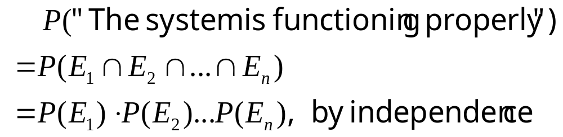
Series system in RBD
Series system of n components.
Components are statistically independent
Define event E_{i} = "component i functions properly.”
For the series system:
R1
R2
Rn

Slide 45
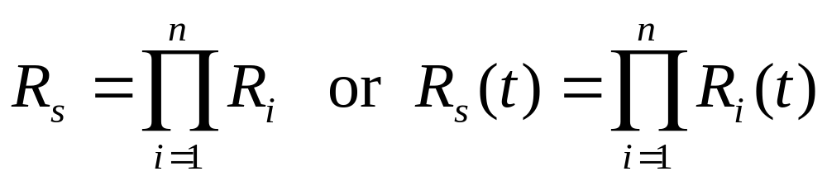
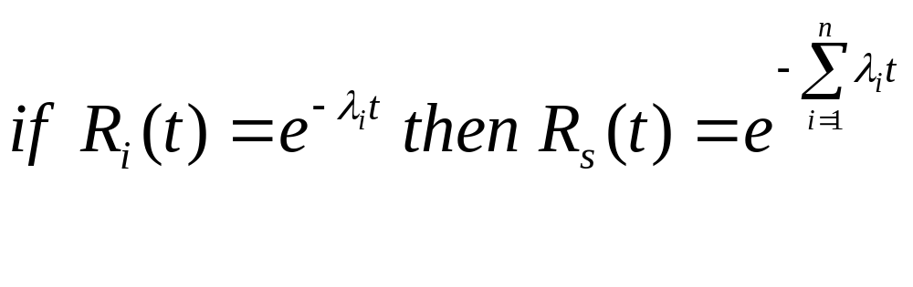
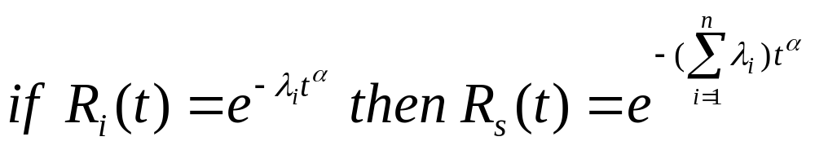
Reliability for Series system
Product law of reliabilities:
where R_{i} is the reliability of component i
For exponential Distribution:
For weibull Distribution:

Slide 46
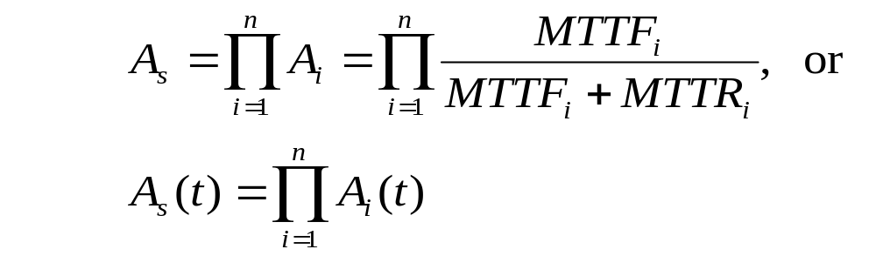
Availability for Series System
Assuming independent repair for each component,
where A_{i} is the (steady state or transient) availability of component i

Slide 47
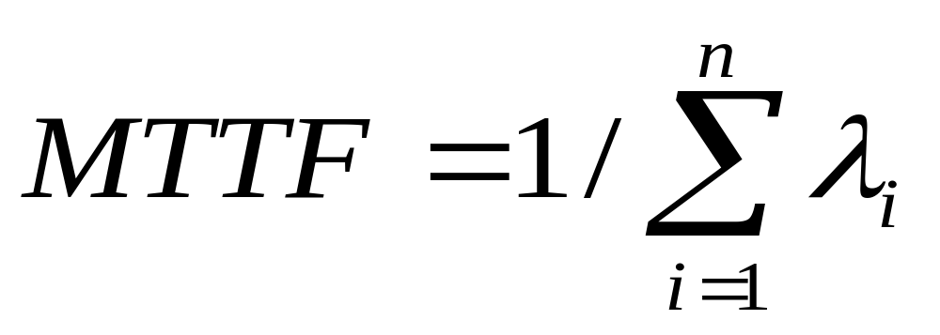
MTTF for Series System
Assuming exponential failure-time distribution with constant failure rate λ_{i} for each component, then:

Slide 48
Parallel system in RBD
A system consisting of n independent components in parallel.
It will fail to function only if all n components have failed.
E_{i} = “The component i is functioning”
E_{p} = "the parallel system of n component is functioning properly."
R1
.
.
.
.
.
.
Rn

Slide 49
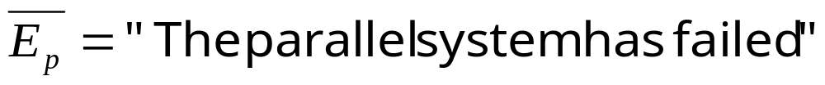
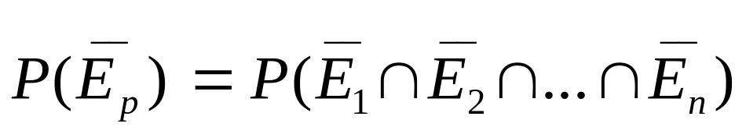
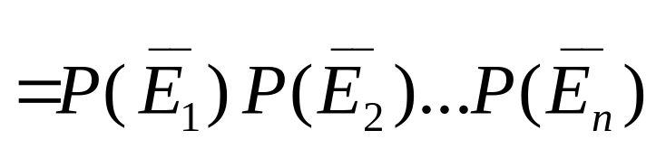
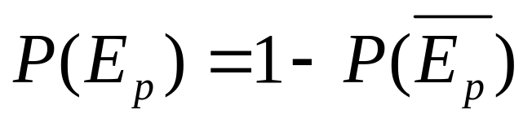
Parallel system in RBD(Continued)
Therefore:

Slide 50
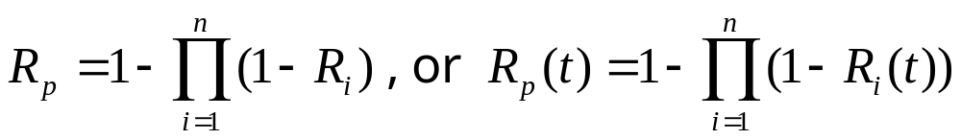
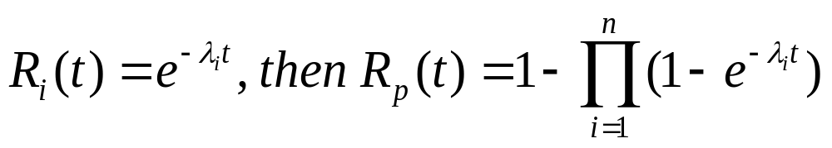
Reliability for parallel system
Product law of unreliabilities
  where R_{i} is the reliability of component i
For exponential distribution:

Slide 51
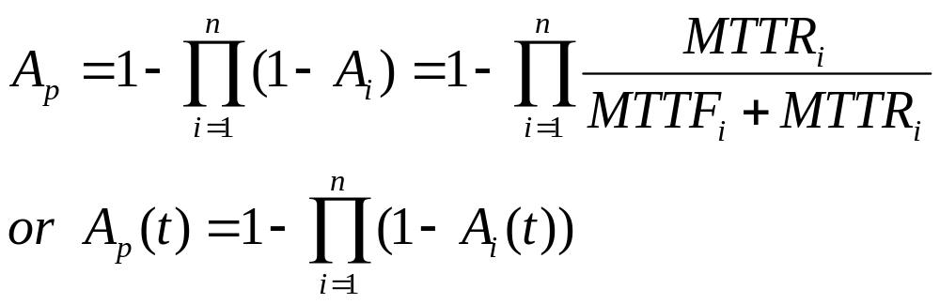
Availability for parallel system
Assuming independent repair,
where A_{i} is the (steady state or transient) availability of component i.

Slide 52


Slide 53

Parallel System Downtime
Parallel System Downtimes
Note that imperfect detection/reconfiguration will drastically reduce the gain due to parallel redundancy

Slide 54

Homework :
For a 2-component parallel redundant system
with EXP( ) behavior, write down expressions for:
  R_{p}(t)
  MTTF_{p}
Further assuming EXP(µ) behavior and independent repair, write down expressions for:
  A_{p}(t)
  A_{p}
  downtime

Slide 55


Homework :
For a 2-component parallel redundant system
with EXP( ) and EXP( ) behavior, write down
expressions for:
  R_{p}(t)
  MTTF_{p}
Assuming independent repair at rates µ₁ and µ₂, write down expressions for:
  A_{p}(t)
  A_{p}
  downtime

Slide 56
Homework :
Show that -log(1-A_{P}) is a linear function of the number of units n assuming identical failure rates and repair rates

Slide 57
Series-Parallel system
voice
control
voice
control
voice
2 Control and 3 Voice Channels Example
System is up as long as 1 control and 1 voice channel are up
The whole system can be treated as a series system with two blocks, each block being a parallel system

Slide 58

Series-Parallel system (Continued)
Each control channel has a reliability R_{c}(t)
Each voice channel has a reliability R_{v}(t)
System is up if at least one control channel and at least 1 voice channel are up.
Reliability:

Slide 59

Homework :
Specialize formula (3) to the case where:
Derive expressions for system reliability and system mean time to failure.

Slide 60

Reliability block diagrams model

Slide 61

Define the components of a reliability block diagrams model

Slide 62

Output definitions

Slide 63

Results of SHARPE

Slide 64

Plot definition

Slide 65

Reliability vs. time

Slide 66

Definition of another plot

Slide 67

Reliability vs. lambda

Slide 68

Mean time to failure vs. lambda

Slide 69
2 control and 3 voice channels example with Fault Tree
Change the problem so that a voice channel can also function as a control channel
We need to use a fault tree with repeated events to model the reliability/availability of the system
Assume that the control channel failure rate is λ_{c} voice channel failure rate is λ_{v}
Repair rates are μ_{c} and μ_{v} respectively.

Slide 70

Fault tree with repeated events

Slide 71

Parameters definition

Slide 72

Distribution functions available

Slide 73

Plot definition

Slide 74

Steady-State Availability vs. repair rate

Slide 75
A Workstations’ File-server Example
Computing system consisting of:
  A file server
  Two workstations
  Computing network connecting them
System operational as long as:
  One of the Workstations
  and
  The file-server are operational
Computer network is assumed to be fault free

Slide 76
The WFS Example
File Server
Computer Network
Workstation 1
Workstation 2

Slide 77
RBD for the WFS Example
Workstation 1
File Server
Workstation 2

Slide 78

RBD for the WFS Example (cont.)
R_{w}(t): workstation reliability
R_{f} (t): file-server reliability
System reliability R(t) is given by:
Note: applies to any time-to-failure distributions

Slide 79




RBD for the WFS Example (cont.)
Assuming exponentially distributed times to failure:
  failure rate of workstation
  failure rate of file-server
The system mean time to failure (MTTF) is
given by:

Slide 80

Comparison Between Exponential and Weibull

Slide 81






Availability Modeling for the WFS Example
Assume that components are repairable
: repair rate of workstation
: repair rate of file-server
: availability of workstation
: availability of file-server

Slide 82


Availability Modeling for the WFS Example (cont.)
System instantaneous availability A(t) is given by:
The steady-state system availability is:

Slide 83
Homework :
For the following system, write
down the expression for system availability:
Assuming for each block a failure rate λ_{i} and
independent restoration at rate μ_{i}
Verify using SHARPE
C
D
A
B
C
E
D
C

Slide 84
K-of-N System in RBD
System consisting of n independent components
System is up when k or more components are operational.
Identical K-of-N system: each component has the same failure and/or repair distribution
Non-identical K-of-N system: each component may have different failure and/or repair distributions

Slide 85
Order Statistics for identical K-of-N
X₁ ,X₂ ,..., X_{n} iid random variables with a common
distribution function F.
Let Y₁ ,Y₂ ,...,Y_{n} be random variables obtained by
permuting the set X₁ ,X₂ ,..., X_{n} so as to be in
increasing order.
To be specific:
Y₁ = min{X₁ ,X₂ ,..., X_{n}}
and
Y_{n} = max{X₁ ,X₂ ,..., X_{n}}

Slide 86
Order Statistics for identical K-of-N (continued)
The random variable Y_{k} is called the k-th ORDER STATISTIC.
If X_{i} is the lifetime of the i-th component in a system of n components. Then:
  Y₁ will be the overall series system lifetime.
  Y_{n} will denote the lifetime of a parallel system.
  Y_{n-k+1} will be the lifetime of an k-out-of-n system.

Slide 87


Order Statistics for identical K-of-N (continued)
To derive the distribution function of Y_{k}, we note that the
probability that exactly j of the X_{i}'s lie in (-∞ ,y] and (n-j) lie
in (y, ∞) is:
hence

Slide 88



Reliability for identical K-of-N
Reliability of identical k out of n system
is the reliability for each component
k=n, series system
k=1, parallel system

Slide 89


Steady-state Availability for Identical K-of-N System
Identical K-of-N Repairable System
  The units operate and are repaired independently
  All units have the same failure-time and repair-time distributions
  Unit failure rate:
  Unit repair rate:

Slide 90


Steady-state Availability for Identical K-of-N System(continued)
Steady-state availability of identical k-of-n system:
where is the steady-state unit availability

Slide 91

Binomial Random Variable
In fact, the number of units that are up at time t (say Y(t)) is binomially distributed. This is so because:
where X_{i} ’s are independent identically distributed Bernoulli random variables. Another way to say this is we have a sequence of n Bernoulli trials.

Slide 92


Binomial Random Variable (cont.)
Y(t) is binomial with parameters n,p

Slide 93

Binomial Random Variable: pmf
p_{k}

Slide 94

Binomial Random Variable: cdf

Slide 95
Homework
Consider a 2 out of 3 system
Write down expressions for its:
  Steady-state availability
  Average cumulative downtime
  System MTTF and MTTR
Verify your results using SHARPE

Slide 96
Homework :
The probability of error in the transmission of a bit over a communication channel is p = 10^{–4}.
What is the probability of more than three errors in transmitting a block of 1,000 bits?

Slide 97
Homework :
Consider a binary communication channel transmitting coded words of n bits each. Assume that the probability of successful transmission of a single bit is p (and the probability of an error is q = 1-p), and the code is capable of correcting up to e (where e > 0) errors. For example, if no coding of parity checking is used, then e = 0. If a single error-correcting Hamming code is used then e = 1. If we assume that the transmission of successive bits is independent, give the probability of successful word transmission.

Slide 98
Homework :
Assume that the probability of successful transmission of a single bit over a binary communication channel is p. We desire to transmit a four-bit word over the channel. To increase the probability of successful word transmission, we may use 7-bit Hamming code (4 data bits + 3 check bits). Such a code is known to be able to correct single-bit errors. Derive the probabilities of successful word transmission under the two schemes, and derive the condition under which the use of Hamming code will improve performance.

Slide 99


Reliability for Non-identical K-of-N System
The reliability for nonidentical k-of-n system is:
That is,
where r_{i} is the reliability for component i

Slide 100



Steady-state Availability for Non-identical
K-of-N System
Assuming constant failure rate λ_{i} and repair rate μ_{i} for each component i, similar to system reliability, the steady state availability for non-identical k-of-n system is:
That is,
where is the availability for component i

Slide 101
Non-series-parallel RBD-Bridge with Five Components
1
2
S
3
T
4
5

Slide 102





Truth Table for the Bridge
Component
1
2
3
4
5
System
Probability
1
1
1
1
1
1
1
1
1
1
1
1
1
1
1
1
1
1
1
1
1
1
1
1
0
0
0
0
0
0
0
0
1
1
1
1
0
0
0
0
1
1
1
1
0
0
0
0
1
1
0
0
1
1
0
0
1
1
0
0
1
1
0
0
1
0
1
0
1
0
1
0
1
0
1
0
1
0
1
0
1
1
1
1
1
1
1
1
1
0
1
0
1
0
0
0

Slide 103




Truth Table for the Bridge
Component
1
2
3
4
5
System
Probability
0
0
0
0
0
0
0
0
0
0
0
0
0
0
0
0
1
1
1
1
1
1
1
1
0
0
0
0
0
0
0
0
1
1
1
1
0
0
0
0
1
1
1
1
0
0
0
0
1
1
0
0
1
1
0
0
1
1
0
0
1
1
0
0
1
0
1
0
1
0
1
0
1
0
1
0
1
0
1
0
1
1
0
0
1
0
0
0
1
0
0
0
1
0
0
0
}

Slide 104

Bridge Availability
From the truth table:

Slide 105
Bridge: Conditioning
1
2
C3 down
S
T
1
2
4
5
S
3
T
4
5
C3 up
1
2
S
T
Factor (condition)
on C3
4
5
Non-series-parallel block diagram

Slide 106
Bridge (cont.)
Component 3 is chosen to factor on
(or condition on)
Upper resulting block diagram: 3 is down
Lower resulting block diagram: 3 is up
Series-parallel reliability formulas applied to both resulting block diagrams
Results combined using the theorem of total probability

Slide 107
Bridge (cont.)
A_{3down}= 1 - (1 - A₁A₂) (1 - A₄A₅)
A_{3up} = [1 - (1-A₁) (1-A₄)] [1 - (1-A₂) (1-A₅)]
A_{bridge} = A_{3down} . (1-A₃ ) + A_{3up} A₃

Slide 108

Homework :
Specialize the bridge reliability formula to the
case where:
  R_{i}(t) =
Find R_{bridge}(t) and MTTF for the bridge
Specialize the bridge availability formula assuming that failure rate of component i is λ_{i} and the restoration rate is μ _{i}
Verify your results using SHARPE

Slide 109
BTS Sector/Transmitter Example

Slide 110
BTS Sector/Transmitter Example
Path 1
(XCVR 1)
Transceiver 1
Power Amp 1
2:1 Combiner
Duplexer 1
(XCVR 2)
Transceiver 2
Power Amp 2
Path 2
(XCVR 3)
Transceiver 3
Power Amp 3
Pass-Thru
Duplexer 2
Path 3
3 RF carriers (transceiver + PA) on two antennas
Need at least two functional transmitter paths in order to meet demand (available)
Failure of 2:1 Combiner or Duplexer 1 disables Path 1 and Path 2

Slide 111
Measures
Steady state System unavailability
System Downtime
Methodology
Fault tree with repeat events (later)
Reliability Block Diagram
  Factoring

Slide 112
We use Factoring
If any one of 2:1 Combiner or Duplexer 1 fails, then the system is down.
If 2:1 Combiner and Duplexer 1 are up, then the system availability is given by the RBD
XCVR1
XCVR2
2|3
XCVR3
Pass-Thru
Duplexer2

Slide 113
XCVR1
XCVR2
2|3
2:1Com
Dup1
XCVR3
Pass-Thru
Dup2
Hence the overall system availability is captured by the RBD

Slide 114


Slide 115
SHARPE input file
format 8
block BTSRBD
comp XCVR ss_unavail(lam,mu)
comp 2:1Com ss_unavail(lam,mu)
comp Dup ss_unavail(lam,mu)
comp Passthru ss_unavail(lam,mu)
series bottom XCVR Passthru Dup
kofn twoofthree 2,3, XCVR XCVR bottom
series serie0 twoofthree 2:1Com Dup
end

Slide 116
SHARPE input file (continued)
bind
lam 1/10000
mu 1/6
end
* Outputs:
var Steady_State_Unavailability sysprob(BTSRBD;)
expr Steady_State_Unavailability
var Downtime 60*8760*sysprob(BTSRBD;)
expr Downtime
end
end
-------------------------------------------
Steady_State_Unavailability: 1.20143224e-03
Downtime: 6.31472786e+02

Slide 117
Methods for Non-series-parallel RBDs
Factoring or Conditioning (done)
Boolean Truth Table (done)
Minpaths
  Inclusion/exclusion
  SDP (Sum of Disjoint Products)
BDD (Binary Decision Diagram)

Slide 118
Homework :
Solve for the bridge reliability
  Using minpaths followed by Inclusion/Exclusion

Slide 119
Fault Trees
Combinatorial (non-state-space) model type
Components are represented as nodes
Components or subsystems in series are connected to OR gates
Components or subsystems in parallel are connected to AND gates
Components or subsystems in kofn (RBD) are connected as (n-k+1)ofn gate

Slide 120
Fault Trees (Continued)
Failure of a component or subsystem causes the corresponding input to the gate to become TRUE
Whenever the output of the topmost gate becomes TRUE, the system is considered failed
Extensions to fault-trees include a variety of different gates NOT, EXOR, Priority AND, cold spare gate, functional dependency gate, sequence enforcing gate

Slide 121
Fault tree (Continued)
Major characteristics:
  Theoretical complexity: exponential in number of components.
Find all minimal cut-sets & then use sum of disjoint products to compute reliability.
Use Factoring or the BDD approach
Can solve fault trees with 100’s of components

Slide 122

An Fault Tree Example
or
Structure Function:
and
and
c1
c2
v1
v2
v3
2 Control and 3 Voice Channels Example

Slide 123


An Fault Tree Example (cont.)
Reliability of the system:

Slide 124
Fault-Tree For The WFS Example

Slide 125

Structure function
Reliability expressions are the same as for the RBD

Slide 126


Availability Modeling Using Fault-Tree
Assume that components are repairable
_{w}: repair rate of workstation
_{f}: repair rate of file-server
A_{w}(t): availability of workstation
A_{f}(t): availability of file-server

Slide 127

Availability Modeling Using Fault-Tree (Continued)
System instantaneous availability A(t) is given by:
A(t) = [1 - (1 - A_{w}(t))²] A_{f}(t)
The steady-state system availability is:

Slide 128
Summary -
Non-State Space Modeling
Non-state-space techniques like RBDs and FTs are easy to represent and assuming statistical independence solve for system reliability, system availability and system MTTF
Each component can have attached to it
  A probability of failure
  A failure rate
  A distribution of time to failure
  Steady-state and instantaneous unavailability

Slide 129
2 Proc 3 Mem Fault Tree
specialized for dependability analysis
represent all sequences of individual component failures that cause system failure in a tree-like structure
top event: system failure
gates: AND, OR, (NOT), K-of-N
Input of a gate:
  -- component
  (1 for failure, 0 for operational)
  -- output of another gate
Basic component and repeated component
failure
and
or
or
and
and
p₁
m₁
m₃
p₂
m₂
m₃
A fault tree example

Slide 130
Fault Tree (Cont.)
For fault tree without repeated nodes
  We can map a fault tree into a RBD
  Use algorithm for RBD to compute MTTF in fault tree
For fault tree with repeated nodes
  Factoring algorithm
  BDD algorithm
  SDP algorithm
Fault Tree | RBD
AND gate | parallel system
OR gate | serial system
k-of-n gate | (n-k+1)-of-n system

Slide 131
Factoring Algorithm for Fault Tree
failure
Basic idea:
and
or
or
M3 has failed
failure
and
p₁
m₁
p₂
m₂
or
or
and
and
failure
and
p₁
m₁
m₃
p₂
m₂
m₃
M3 has not failed
p₁
p₂

Slide 132
BTS Sector/Transmitter Example
Revisited

Slide 133


Slide 134
SHARPE input file
format 8
ftree BTS_sector
repeat Dupl ss_unavail(1/10000,1/6)
basic Passthru ss_unavail(1/10000,1/6)
basic XCVR ss_unavail(1/10000,1/6)
basic Dupl2 ss_unavail(1/10000,1/6)
repeat Comb. ss_unavail(1/10000,1/6)
or or2 XCVR Passthru Dupl2
or or1 XCVR Comb. Dupl
or or0 XCVR Comb. Dupl
kofn kofn0 2, 3, or0 or1 or2
end

Slide 135
SHARPE input file (continued)
* Outputs:
var Steady_State_Unavailability sysprob(BTS_sector;)
expr Steady_State_Unavailability
var Downtime 60*8760*sysprob(BTS_sector;)
expr Downtime
end
end
-------------------------------------------
Steady_State_Unavailability: 1.20143224e-03
Downtime: 6.31472786e+02

